Slide 1

Woodlands Pupil Council
Giving our pupils a voice!

Slide 2

What does a pupil council do?
A pupil council lets the pupils of woodlands come together and work to make the best school possible by talking about: -Things we would like to add in the school, like new playground equipment or water fountains -Problems pupils might have

Slide 3
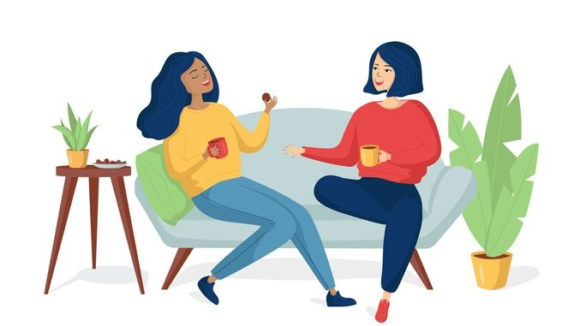
Who is going to be on it?
We are looking for one pupil from each class to be a part of the pupil council. You must be sensible, reliable and can work as part of a team. In the Council you must: -Listen carefully to others.
-Attend meetings every two weeks with Mr Jack
-Make suggestions and share ideas
-Take on responsibilities

Slide 4
Are you interested?
If you want to be on the Pupil Council, tell your teacher you’re interested and they will pass it on to Mr Jack. If more than one person volunteers in your class, your class will have a vote on who they think it should be. Remember – not everyone can be in it, so don’t be upset if you aren’t chosen: there’s always next year!

Slide 5

Teachers – cut off for your pupil council members are to be sent to Mr Jack no later than the 7th of February. The members from each class will then be announced in the assembly after the February holiday.
Good luck everyone and thanks for listening!

