Slide 1
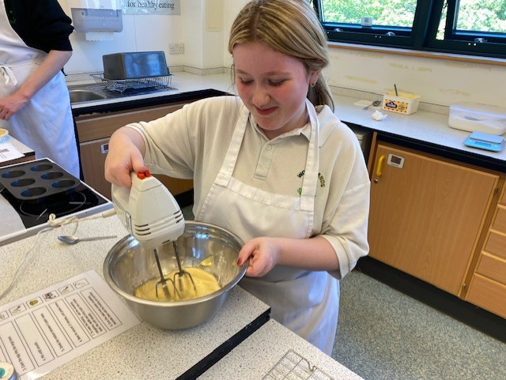
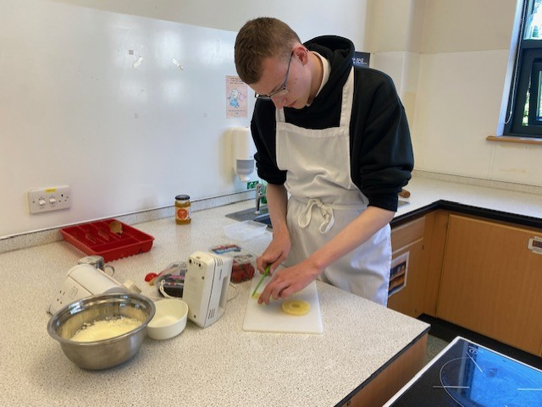
We took part in a Future Chef competition on Tuesday 13th May…

Slide 2
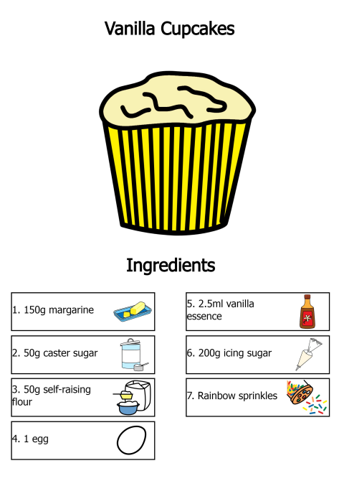
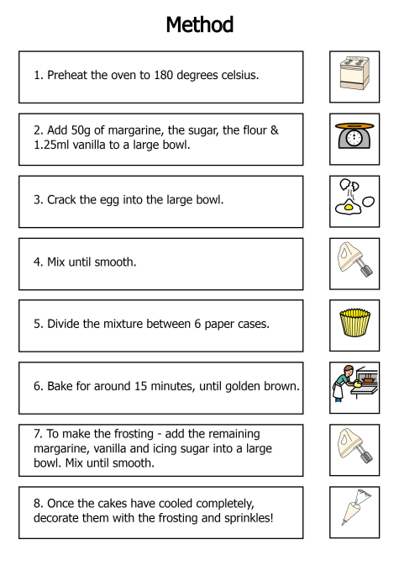
We both chose our own recipes…

Slide 3
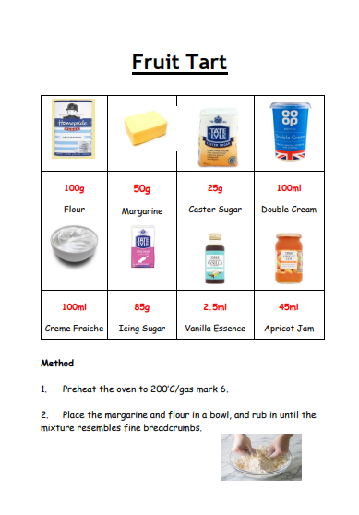
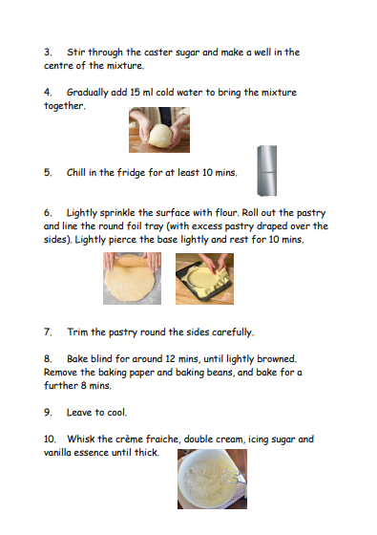
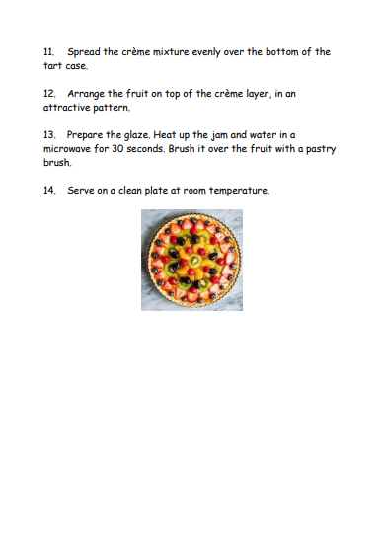
We both chose our own recipes…

Slide 4
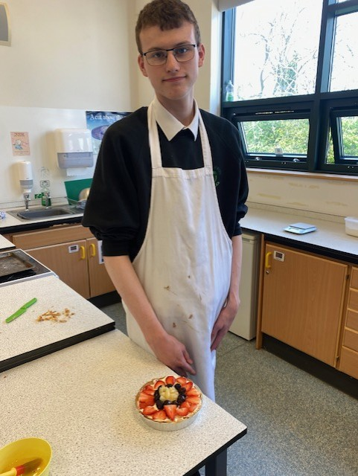
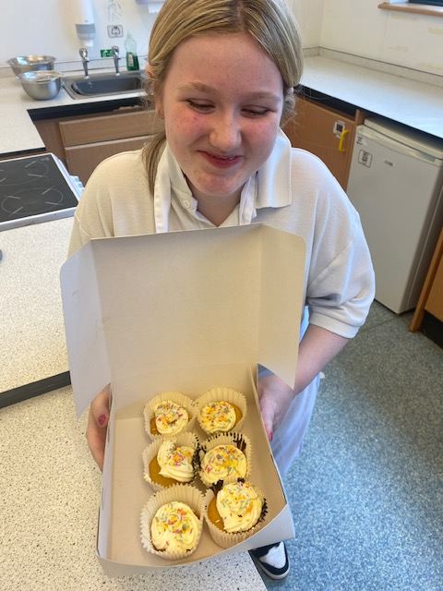
We both practised hard before the competition…

Slide 5
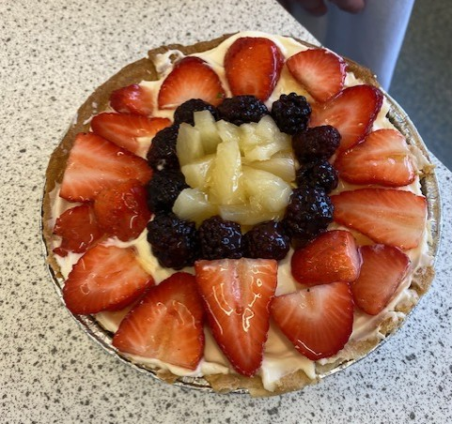
And we learned from our mistakes…
When I (Ryan) practised the fruit tart recipe for the first time, the pastry was a bit burnt. Next time, I turned the oven to a lower temperature to stop it happening again.

Slide 6
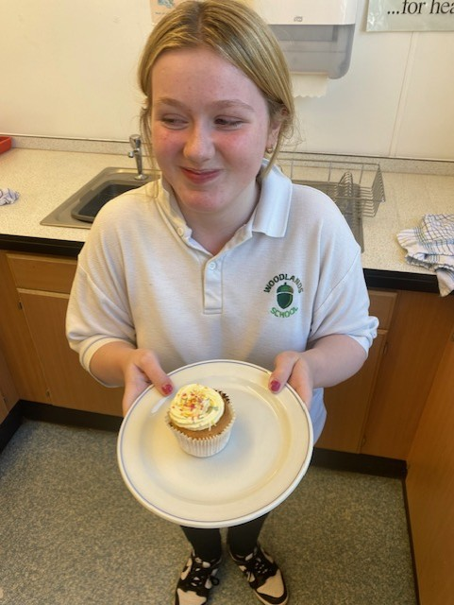
Competition Day!

Slide 7
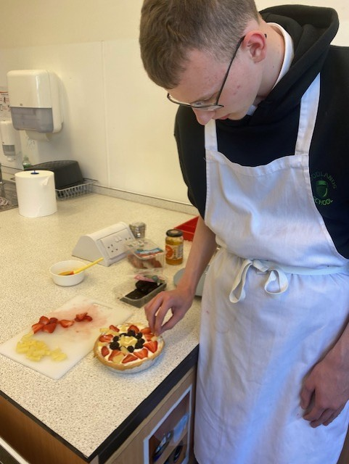
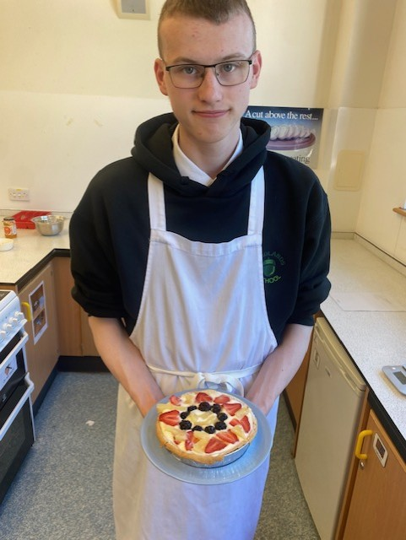
Competition Day!

Slide 8
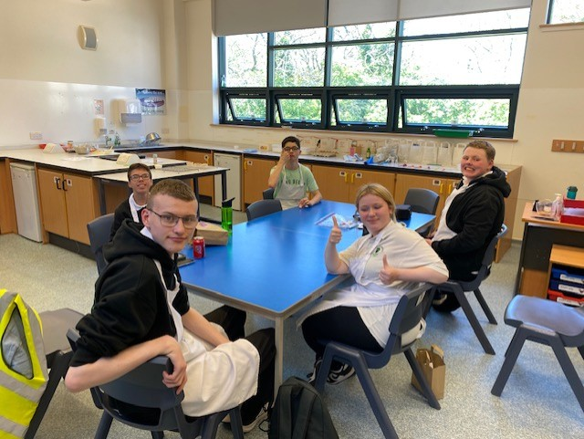
We were competing against pupils from Pilrig Park, Kaimes and Meadowpark…

Slide 9
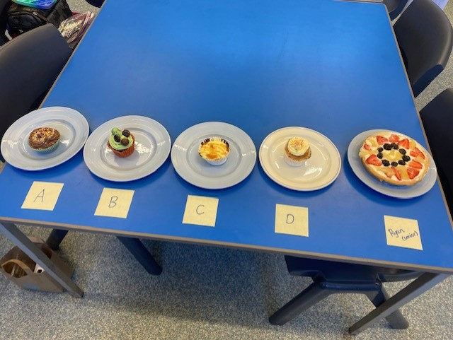
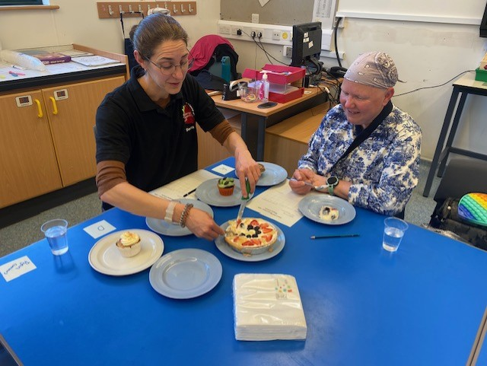
We all presented our dishes to the judges…

Slide 10
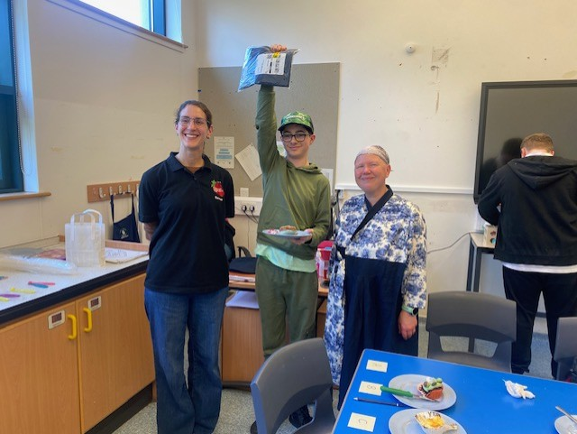
The winner was Leland from Kaimes!

Slide 11
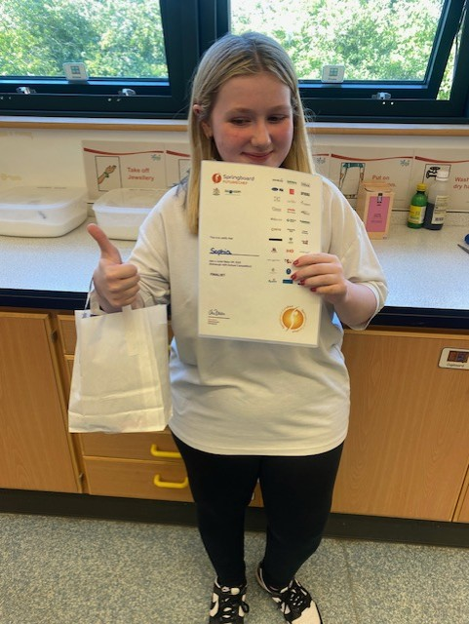
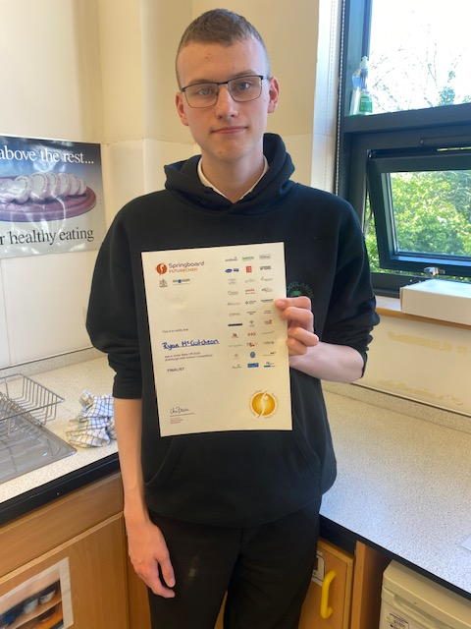
We got certificates and a goodie bag for taking part ☺
We had lots of fun!

