Slide 1

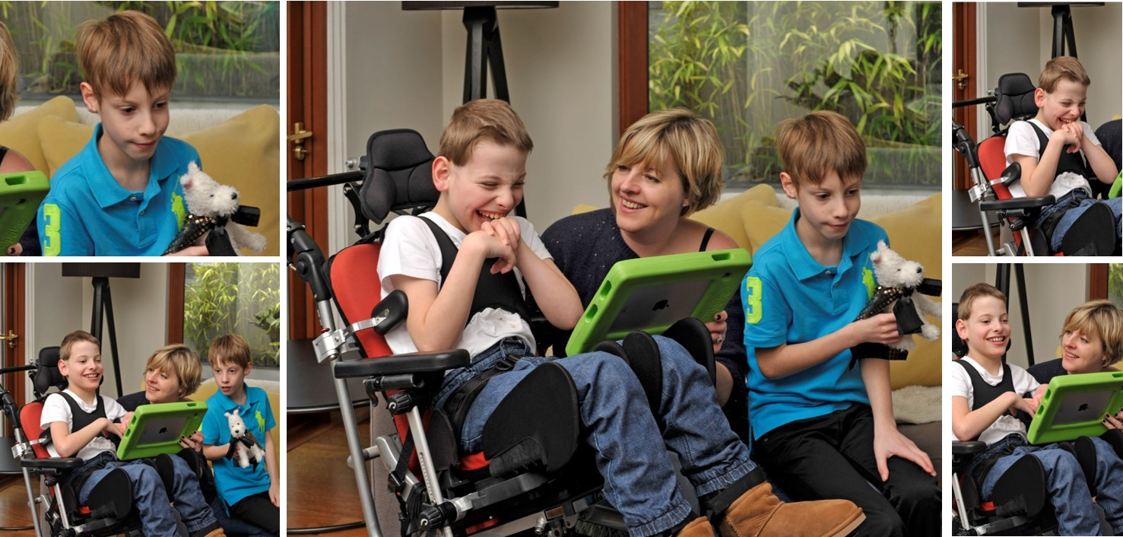
Person’s Name’s Digital Passport
Notes:
This is the outside cover and is usually a recent photo of the person. The person’s photo is accompanied by their name and a short introductory sentence inviting the reader to find out about the person.

Slide 2
Me, my family and friends
Notes:
The next few pages will tell the reader about him/her self and give insight into the person’s important people in his or her life. If you only have enough information for one page that is fine also.
But remember, you can customise the passport including the number of pages dedicated to each chapter/section.

Slide 3


Me
You can add as many extra slides as you like by going to “insert… duplicate selected slide” this will retain the navigation system within the passport
Notes:
Some information about the person’s diagnosis, if there is one, and condition can be included here. Information on how this impacts on his/her daily life can be included here

Slide 4
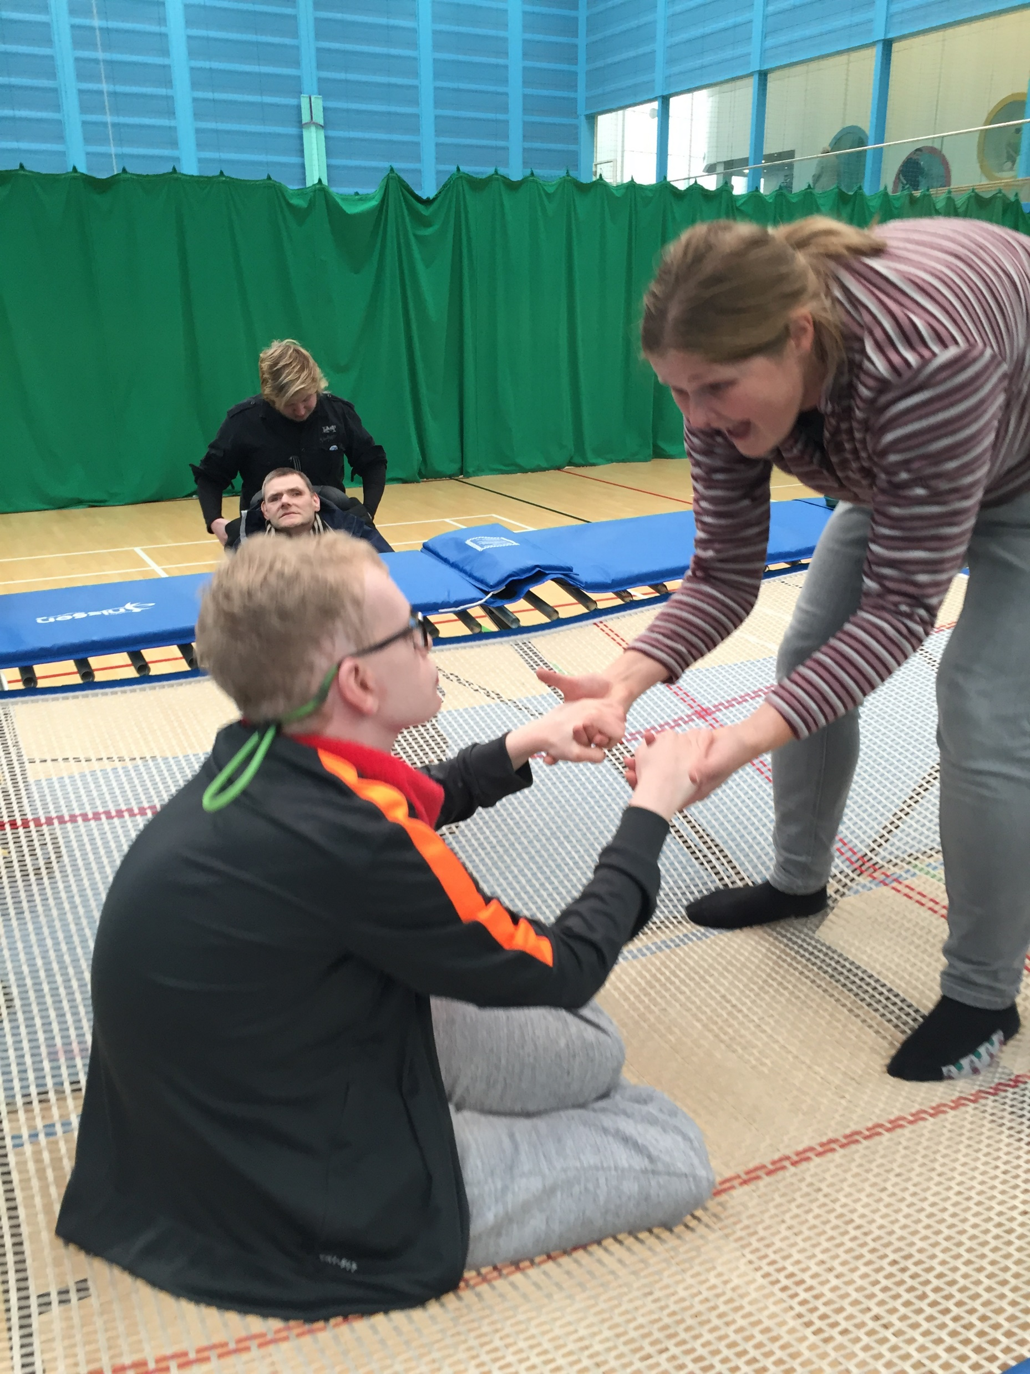
Me
Liam on the trampoline
Notes:
Some information about the person’s diagnosis, if there is one, and condition can be included here. Information on how this impacts on his/her daily life can be included here

Slide 5
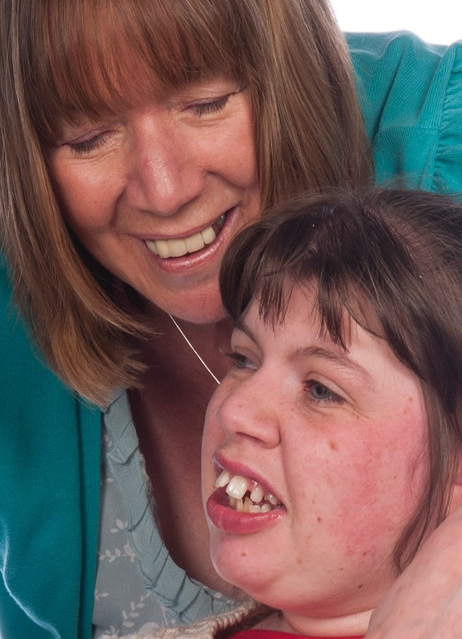
My family
Type Here…
Think about using older family photos as well. This is a really good place to capture people’s cultural legacies. Think about things like videos of relatives telling family stories, stories from school, special memories and things the person likes to do with particular people.
Notes:
Some information about the person’s diagnosis, if there is one, and condition can be included here. Information on how this impacts on his/her daily life can be included here

Slide 6
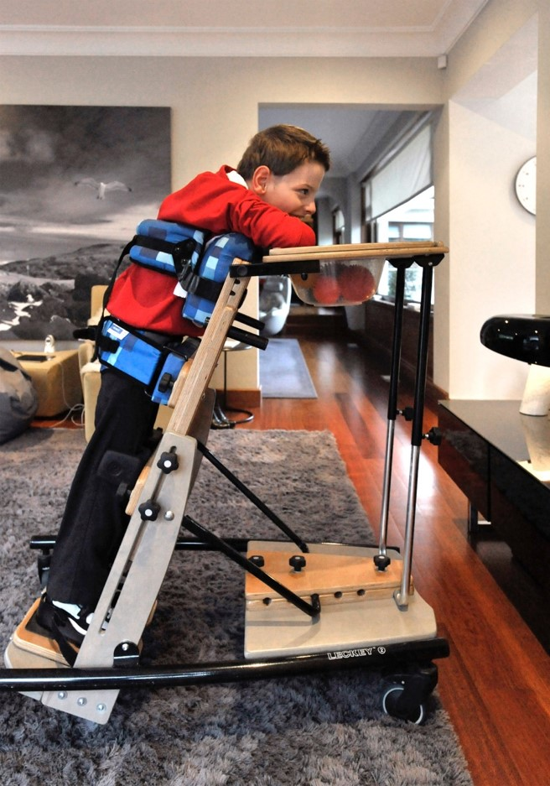
My family
Type Here…
Notes:
Some information about the person’s diagnosis, if there is one, and condition can be included here. Information on how this impacts on his/her daily life can be included here

Slide 7
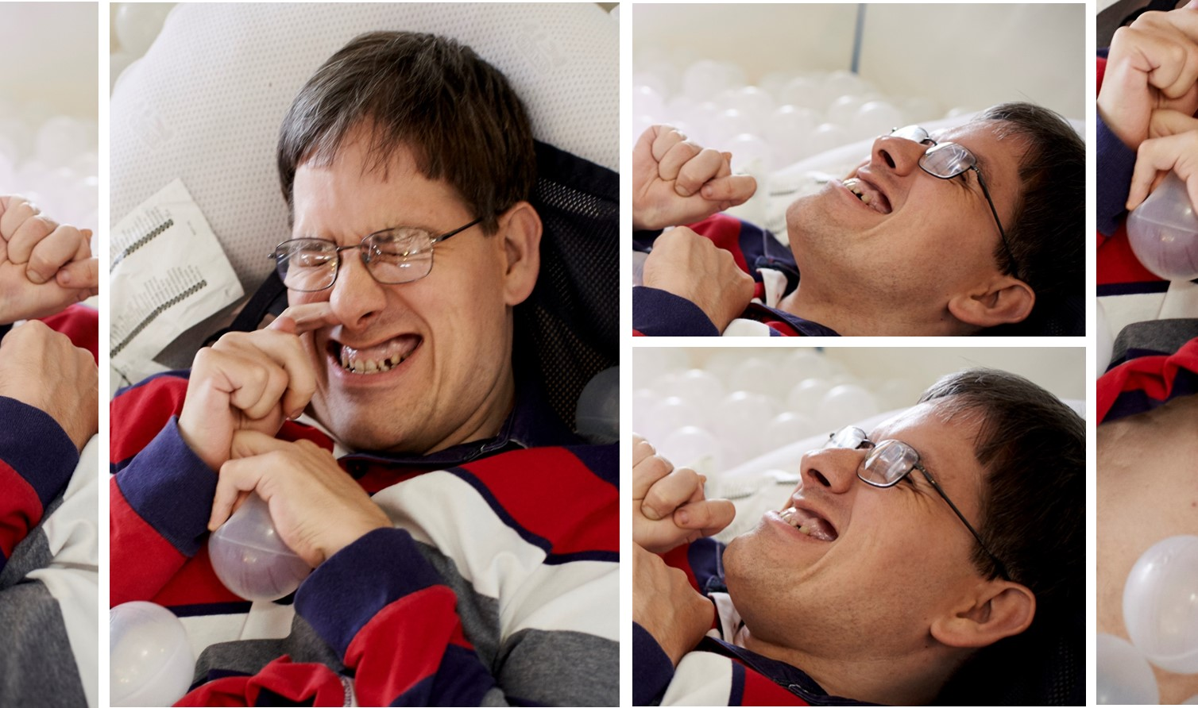
Things I like and dislike
Notes:
The next few slides are around what the person likes to do such as music, swimming, wheelchair dancing, going on holiday, being with friends, etc. It is helpful if there are lots of photos and or videos to bring pages to life and give the reader a real sense of what the person does and enjoys in life.
A person’s likes and dislikes can also help the reader to gain an insight into the person’s personality and character. It enables the reader to understand that activities that are enjoyed should be encouraged to continue. On the same note sharing the person’s dislike of certain activities, settings or situations can also help any supportive person understand that some aspects of everyday life are best avoided to circumvent un-necessary distress.

Slide 8
Things I like
These are only ideas;
You can add video, photographs or text into this section… the more vivid and expressive the better. It can also be used to show how someone indicates how they like or dislike something or someone and how they give consent to taking part in an activity or pass time.
Notes:
Some information about the person’s diagnosis, if there is one, and condition can be included here. Information on how this impacts on his/her daily life can be included here

Slide 9
Things I dislike
Notes:
Some information about the person’s diagnosis, if there is one, and condition can be included here. Information on how this impacts on his/her daily life can be included here

Slide 10

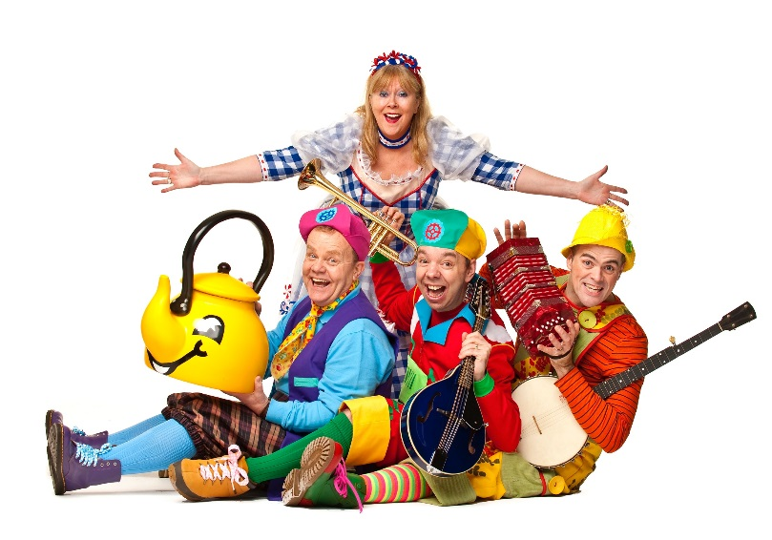
My media
If you have created a private youtube channel, why not use this page to link into it? You could also put in links to favourite programmes, or use the pages to put pictures of familiar characters in the books people read.
Notes:
Some information about the person’s diagnosis, if there is one, and condition can be included here. Information on how this impacts on his/her daily life can be included here

Slide 11
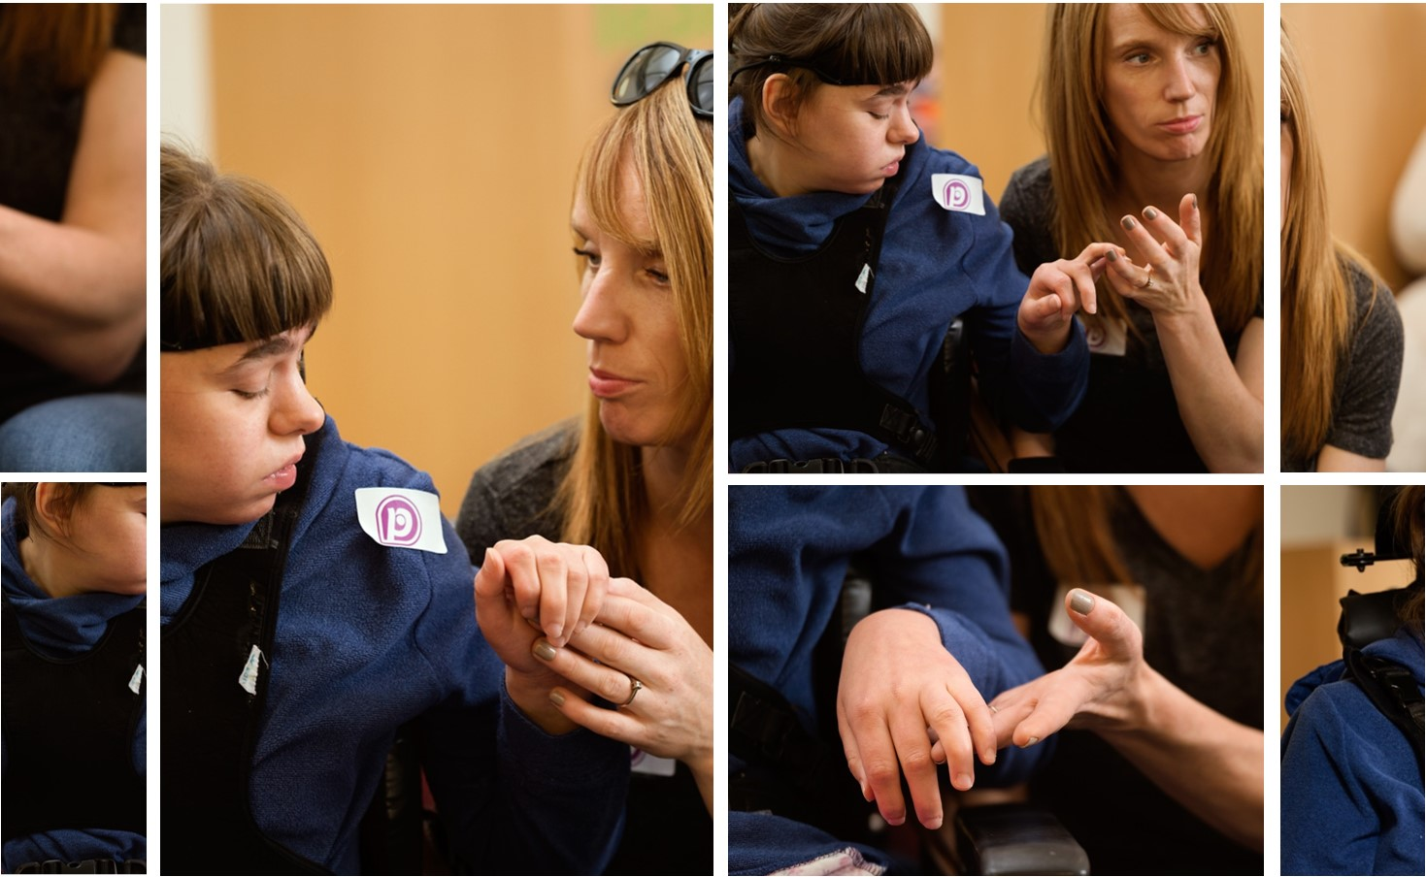
My care needs and abilities
Notes:
This section can have specific care needs addressed.
Again remember you can customise the passport including the number of pages dedicated to each chapter.
Some families find it useful to include short videos to show how some everyday procedures should be carried out. Videos can help ensure that your relative’s care staff have not only received relevant training on how to carry out specific procedures but have a back-up video to remind staff how to carry out necessary procedures correctly. This can be in relation to procedures such as gastrostomy feeding. Other everyday procedures can also have accompanying videos to aid their completion such as:
Demonstrating particular ways of presenting food
Positioning for maximum comfort
Sleep positioning
Best ways of interacting with the person etc.

Slide 12
Supporting me through the day
Notes:
Some information about the person’s diagnosis, if there is one, and condition can be included here. Information on how this impacts on his/her daily life can be included here

Slide 13
Eating and Drinking
Do I have an eating and drinking plan?
Do I need my food prepared in a particular way?
Do I have a safe or unsafe swallow?
Do I use a flo-pump or bolus equipment?
How am I positioned?
If someone feeds me, do I have a preferred side?
On what date is this information correct?
Notes:
If your relative has a support team it is useful to have a page with photos of them too. However, it can be difficult to include everyone or it may be that staff members rotate etc. If this is the case alerting the reader to the organisation involved may be sufficient with only long term staff photographs actually included.

Slide 14
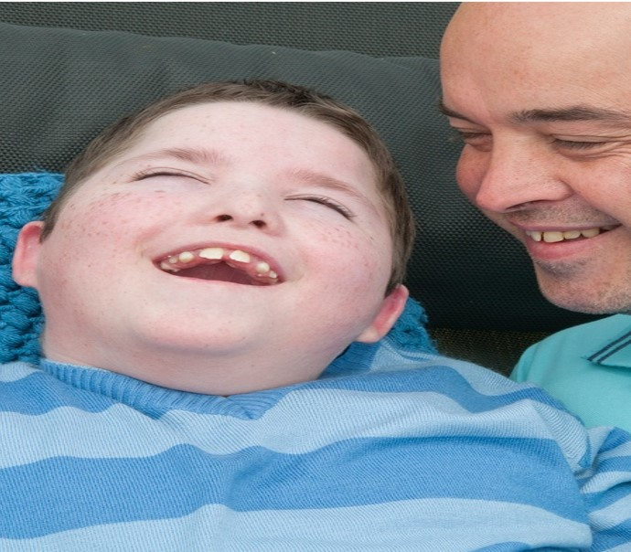
Oral Health
Do I brush my own teeth?
Do I need support?
Do I have a particular brush that I use?
Do I use a timer?
Does someone brush my teeth for me?
Is there a video to show how to brush my teeth correctly and appropriately?
How do I need to be positioned while my teeth are being brushed?
Do I use a particular toothpaste (non foaming or high fluoride?)
Do I use artificial saliva?
Notes:
If your relative has a support team it is useful to have a page with photos of them too. However, it can be difficult to include everyone or it may be that staff members rotate etc. If this is the case alerting the reader to the organisation involved may be sufficient with only long term staff photographs actually included.

Slide 15
My Daily Routine
Morning
Afternoon
Evening
Use this page for things that occur every day. Go over onto another slide if you need to- some people use a whole slide for each morning/afternoon or evening
Notes:
If your relative has a support team it is useful to have a page with photos of them too. However, it can be difficult to include everyone or it may be that staff members rotate etc. If this is the case alerting the reader to the organisation involved may be sufficient with only long term staff photographs actually included.

Slide 16
My Weekly Routine
Monday
Tuesday
Wednesday
Thursday
Friday
Saturday
Sunday
Notes:
If your relative has a support team it is useful to have a page with photos of them too. However, it can be difficult to include everyone or it may be that staff members rotate etc. If this is the case alerting the reader to the organisation involved may be sufficient with only long term staff photographs actually included.

Slide 17
My Weekend Routine
Saturday Morning
Afternoon
Evening
Sunday Morning
Afternoon
Evening
Notes:
If your relative has a support team it is useful to have a page with photos of them too. However, it can be difficult to include everyone or it may be that staff members rotate etc. If this is the case alerting the reader to the organisation involved may be sufficient with only long term staff photographs actually included.

Slide 18
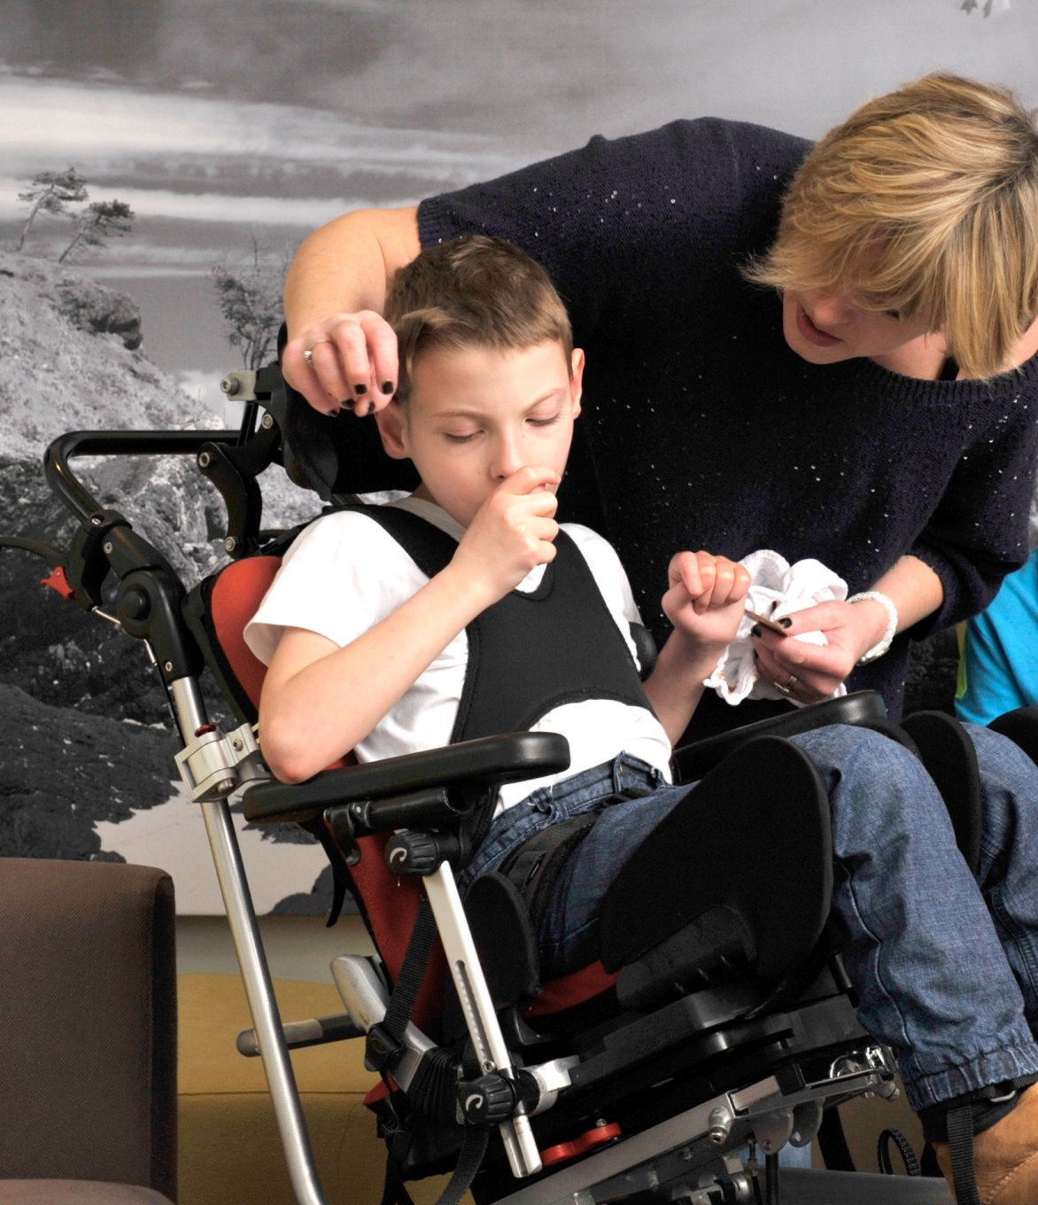
Postural Care and Management
Postural care is not intuitive!
Simple Stuff Works tells us that:
“Postural Care is the gentle, respectful, consistent and effective means of protecting body shape”
Postural care impacts on:
breathing
eating and drinking
pain
communication, behaviour & relationships
overall, quality of life
Tap here to watch an Introduction to Postural Care
Notes:
Some information about the person’s diagnosis, if there is one, and condition can be included here. Information on how this impacts on his/her daily life can be included here

Slide 19
The Mansefield Checklist of Need for Posture Care
Any person who finds it difficult to vary and control their position during the day or night may be in need of postural care.
Is the person limited to restricted number of positions?
Does the head seem to turn mainly to one side?
Does the body seem to fall sideways?
Does the body seem to fall forwards or backwards?
Do the knees seem to fall mainly to one side?
Do the knees seem to fall inwards or outwards?
Is the body shape already asymmetric?
If you can answer “yes” to any of the above, think carefully about whether the person needs physical support to protect and restore their body shape, muscle tone and quality of life. Confer with all those involved to decide if being on the Postural Care Pathway would be helpful to them.
Notes:
If your relative has a support team it is useful to have a page with photos of them too. However, it can be difficult to include everyone or it may be that staff members rotate etc. If this is the case alerting the reader to the organisation involved may be sufficient with only long term staff photographs actually included.

Slide 20
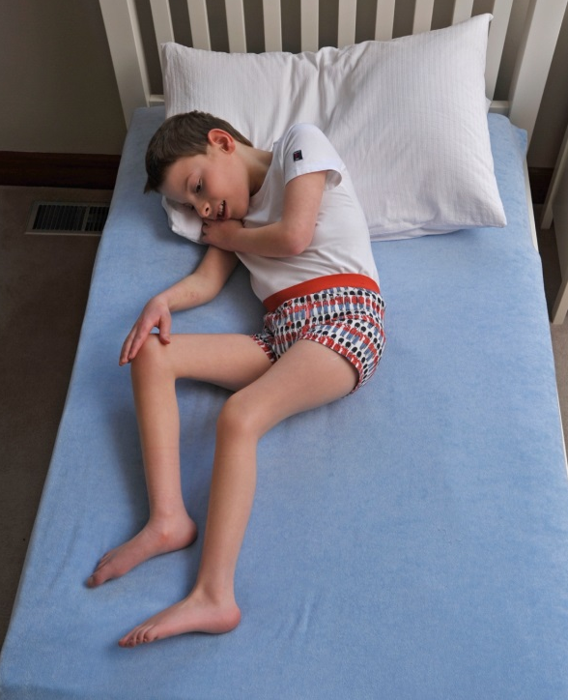
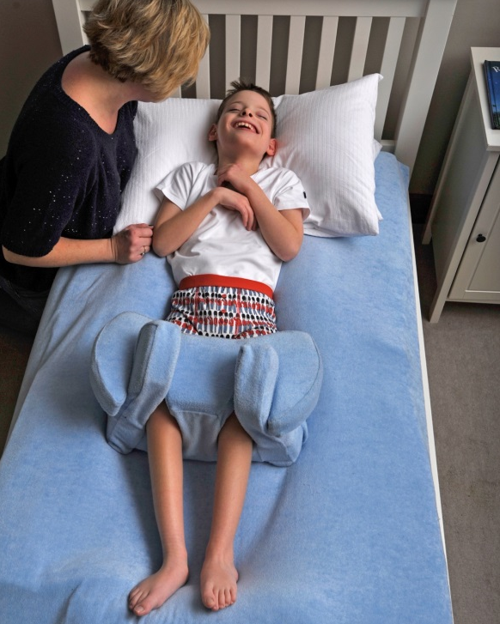
Postural Care for Lying
Unsupported Position
Supported Position
Ensure head, trunk, pelvis and legs are positioned centrally and symmetrically aligned where possible. Ensure head and extended knees are supported by a pillow or other system.
Notes:
If your relative has a support team it is useful to have a page with photos of them too. However, it can be difficult to include everyone or it may be that staff members rotate etc. If this is the case alerting the reader to the organisation involved may be sufficient with only long term staff photographs actually included.

Slide 21
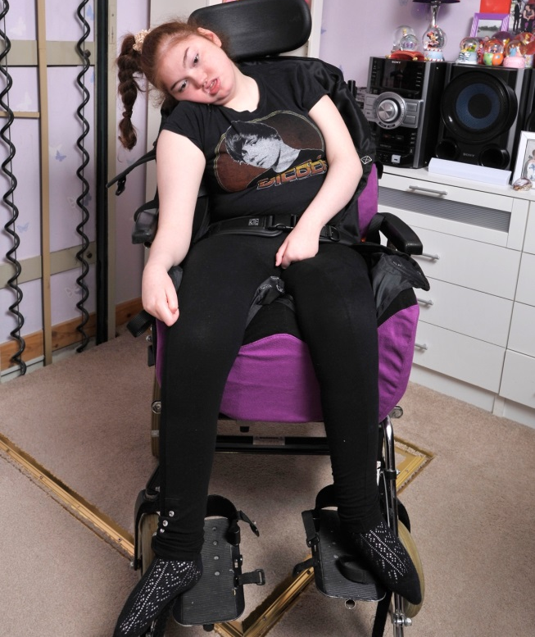
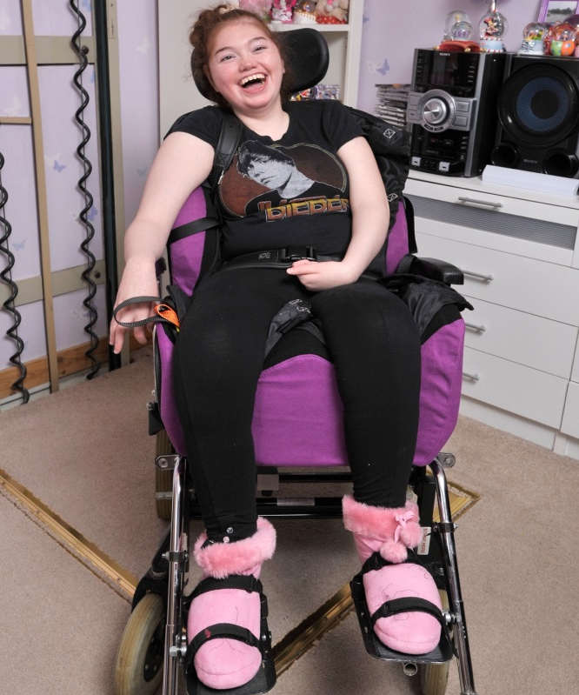
Postural Care for Sitting
Ensure bottom is positioned well back in chair and pelvic strap secured firmly where present. Ensure feet are supported and head and trunk positioned and supported in an upright, midline position where possible.
Unsupported Position
Supported Position
Notes:
If your relative has a support team it is useful to have a page with photos of them too. However, it can be difficult to include everyone or it may be that staff members rotate etc. If this is the case alerting the reader to the organisation involved may be sufficient with only long term staff photographs actually included.

Slide 22

Postural Care for Standing
Supported Position
Ensure positioned centrally on frame with symmetrical posture as able
Encourage upright trunk and head position with hips and knees extended
Notes:
If your relative has a support team it is useful to have a page with photos of them too. However, it can be difficult to include everyone or it may be that staff members rotate etc. If this is the case alerting the reader to the organisation involved may be sufficient with only long term staff photographs actually included.

Slide 23
Sight and hearing
Do I need glasses and are my glasses clean? Do I wear them in a certain way? Do I need sunglasses to go outside?
Do I wear a hearing aid? Where are the batteries and who is responsible for noticing they need changed?
Notes:
If your relative has a support team it is useful to have a page with photos of them too. However, it can be difficult to include everyone or it may be that staff members rotate etc. If this is the case alerting the reader to the organisation involved may be sufficient with only long term staff photographs actually included.

Slide 24
Sensory Support
Do I have a sensory profile?
Is there any information to support my sensory needs?
Notes:
If your relative has a support team it is useful to have a page with photos of them too. However, it can be difficult to include everyone or it may be that staff members rotate etc. If this is the case alerting the reader to the organisation involved may be sufficient with only long term staff photographs actually included.

Slide 25
My Equipment
Adding in pictures of pieces of equipment and using further slides to show how to use the equipment with the person can be useful here.
Links to servicing for pieces of equipment ie telephone numbers and websites can be included in the contacts section with a note of which piece of equipment the number refers to.
Notes:
If your relative has a support team it is useful to have a page with photos of them too. However, it can be difficult to include everyone or it may be that staff members rotate etc. If this is the case alerting the reader to the organisation involved may be sufficient with only long term staff photographs actually included.

Slide 26

Sports and Leisure Activities
There is a section at the back for specific documents, but you may want to add slides about how someone communicates, the accommodations they might need or equipment to take part in an activity (not only a risk assessment) activities someone has enjoyed in the past, what they haven’t enjoyed and why, whether they like soft or vigorous movement, if they have a short attention span, if they need a practitioner assessment prior to taking part in an activity (i.e. for rebound therapy or swimming)
You might want to add videos of activities taking place and refer to positioning and communication guidance as well.
Notes:
If your relative has a support team it is useful to have a page with photos of them too. However, it can be difficult to include everyone or it may be that staff members rotate etc. If this is the case alerting the reader to the organisation involved may be sufficient with only long term staff photographs actually included.

Slide 27
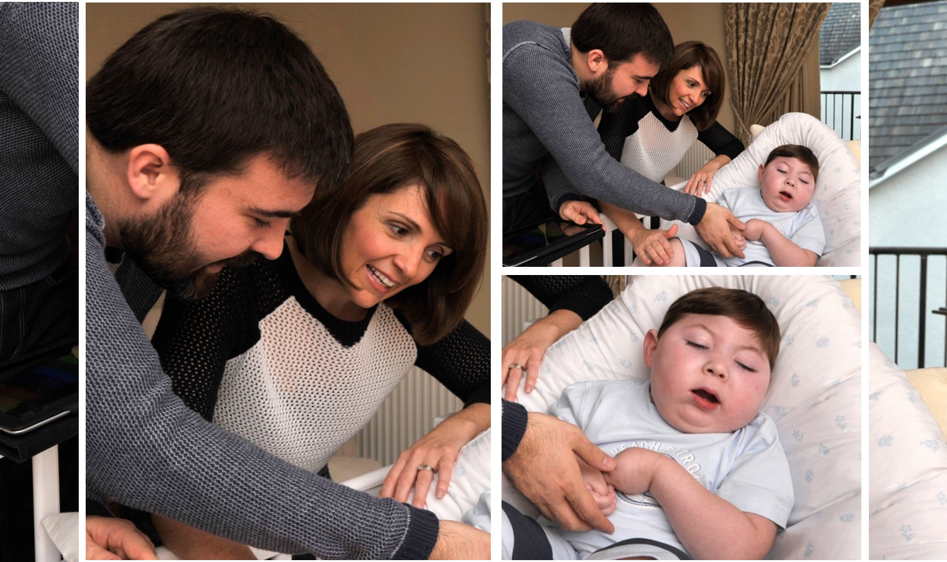
My communication
Notes:
Descriptions of how the person acts when happy or sad will alert staff to how he or she communicates these emotions. Again the use of photographs and videos are really helpful. Including useful videos, photo and information on how the person lets you know what and how he/she is feeling will help avoid misunderstanding and promote interaction between the person and his/her carers.

Slide 28
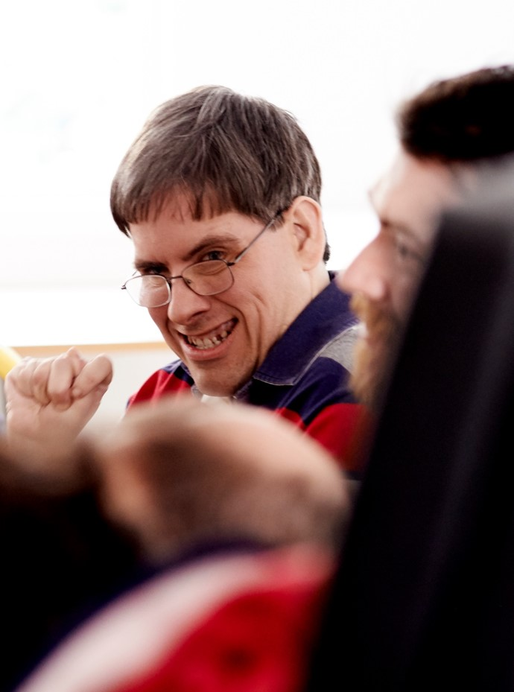
My Communication
How do I like to be spoken to? What will make things easier? Do I use PECS symbols? Do I use Eye Gaze? What is my non-verbal communication?
Is there an opportunity to use video to record someone’s unique language?
Notes:
If your relative has a support team it is useful to have a page with photos of them too. However, it can be difficult to include everyone or it may be that staff members rotate etc. If this is the case alerting the reader to the organisation involved may be sufficient with only long term staff photographs actually included.

Slide 29
My Communication
Please do:
use clear instructions, with a calm voice
keep language to a minimum, using simple words and short sentences
give me time to process
make eye-contact with me
give me only two options when asking for me to make a choice
allow me to take the lead – this makes me feel in control and that I am being listened to
talk me through things
Please don’t:
bombard me with language
rush me
make too many requests at once
Notes:
If your relative has a support team it is useful to have a page with photos of them too. However, it can be difficult to include everyone or it may be that staff members rotate etc. If this is the case alerting the reader to the organisation involved may be sufficient with only long term staff photographs actually included.

Slide 30
Communication and Activities
For example -
one-to-one
with support and encouragement
when I am not being rushed. I like to do things at my own pace
when doing interesting activities
How do I indicate I don’t want to do an activity?
Notes:
If your relative has a support team it is useful to have a page with photos of them too. However, it can be difficult to include everyone or it may be that staff members rotate etc. If this is the case alerting the reader to the organisation involved may be sufficient with only long term staff photographs actually included.

Slide 31
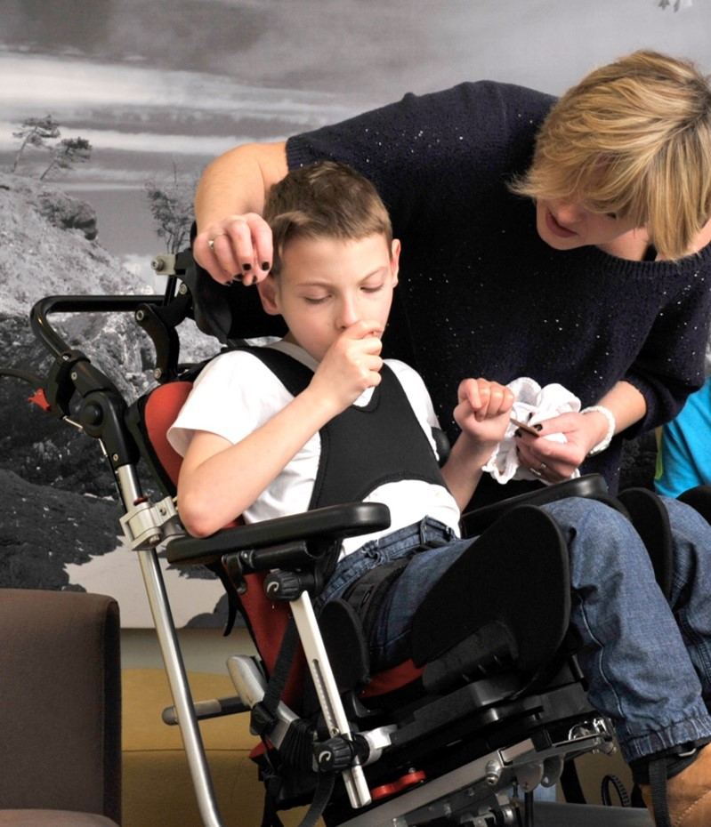
Using Communication Aids
Do I use a communication system? PECS? Would it be useful to include PECS symbols in the passport? Do I use a “big mac”? Do I use gesture or non-verbal communication? Do I use objects of reference as signifiers. Do I eye-point?
Notes:
If your relative has a support team it is useful to have a page with photos of them too. However, it can be difficult to include everyone or it may be that staff members rotate etc. If this is the case alerting the reader to the organisation involved may be sufficient with only long term staff photographs actually included.

Slide 32
Positive Behavioural Support
The Challenging Behaviour Foundation is a charity for peoplewith severe learning disabilities whose behaviour challenges.
They have developed the Positive Behavioural Support tool, which supports families, paid carers and professionals better understand the behaviour of the person. You may find this tool useful when completing and reading this section of the Digital Passport.
Notes:
If your relative has a support team it is useful to have a page with photos of them too. However, it can be difficult to include everyone or it may be that staff members rotate etc. If this is the case alerting the reader to the organisation involved may be sufficient with only long term staff photographs actually included.

Slide 33
Positive Behavioural Support
Setting Events are things which might make me feel unhappy, and can contribute to difficult behaviour.
I might become upset when:
I don’t feel well
in a strange place
surrounded by strangers
not being understood
change in your tone of voice
being rushed
asked to do something I don’t want to do
If I am upset or frustrated, I may grab, pull and reach for your skin or clothes. This is because I feel overwhelmed or I am unhappy. Please try to understand.
If you can see that I am beginning to feel frustrated, reduce any demands on me, distract me and sing me a song.
Notes:
If your relative has a support team it is useful to have a page with photos of them too. However, it can be difficult to include everyone or it may be that staff members rotate etc. If this is the case alerting the reader to the organisation involved may be sufficient with only long term staff photographs actually included.

Slide 34
Support Plan – Green “i’m ok”
Behaviour | Support Strategy
Notes:
If your relative has a support team it is useful to have a page with photos of them too. However, it can be difficult to include everyone or it may be that staff members rotate etc. If this is the case alerting the reader to the organisation involved may be sufficient with only long term staff photographs actually included.

Slide 35
Support Plan – Amber “I’m anxious”
Behaviour | Support Strategy
Notes:
If your relative has a support team it is useful to have a page with photos of them too. However, it can be difficult to include everyone or it may be that staff members rotate etc. If this is the case alerting the reader to the organisation involved may be sufficient with only long term staff photographs actually included.

Slide 36
Support Plan – Red “i’m struggling”
Behaviour | Support Strategy
Notes:
If your relative has a support team it is useful to have a page with photos of them too. However, it can be difficult to include everyone or it may be that staff members rotate etc. If this is the case alerting the reader to the organisation involved may be sufficient with only long term staff photographs actually included.

Slide 37
Support Plan – Blue “i’m settling”
Behaviour | Support Strategy
Notes:
If your relative has a support team it is useful to have a page with photos of them too. However, it can be difficult to include everyone or it may be that staff members rotate etc. If this is the case alerting the reader to the organisation involved may be sufficient with only long term staff photographs actually included.

Slide 38
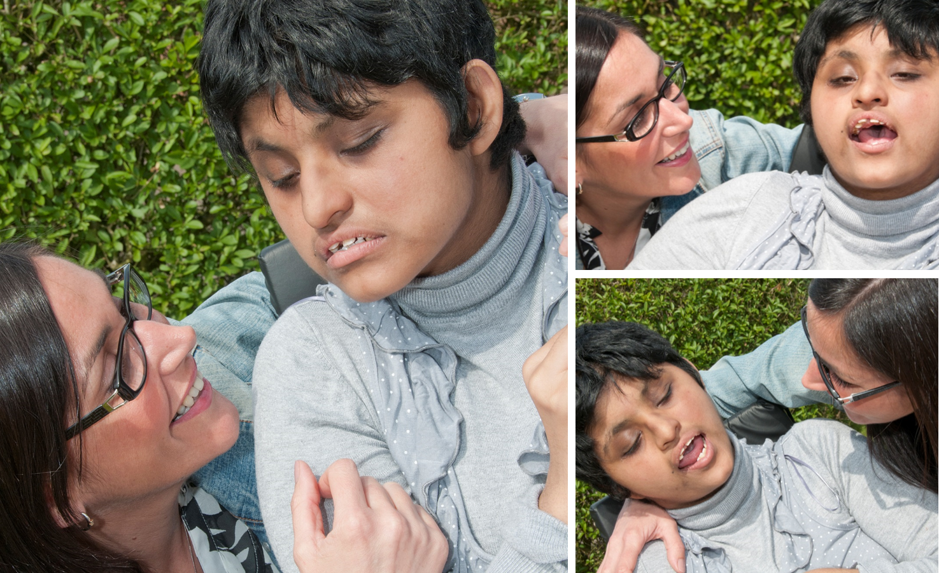
Future wishes
Notes:
Discussion around future wishes is especially important especially if family carers are elderly or no longer able to care for the person full time. Making sure that future wishes are documented can be invaluable should the primary carers, usually family carers, be unable to care in the future.

Slide 39
Future Wishes
These could include going on holiday, an activity, a concert or where they would like to live. It can be as near or far into the future as the person likes.
Notes:
If your relative has a support team it is useful to have a page with photos of them too. However, it can be difficult to include everyone or it may be that staff members rotate etc. If this is the case alerting the reader to the organisation involved may be sufficient with only long term staff photographs actually included.

Slide 40
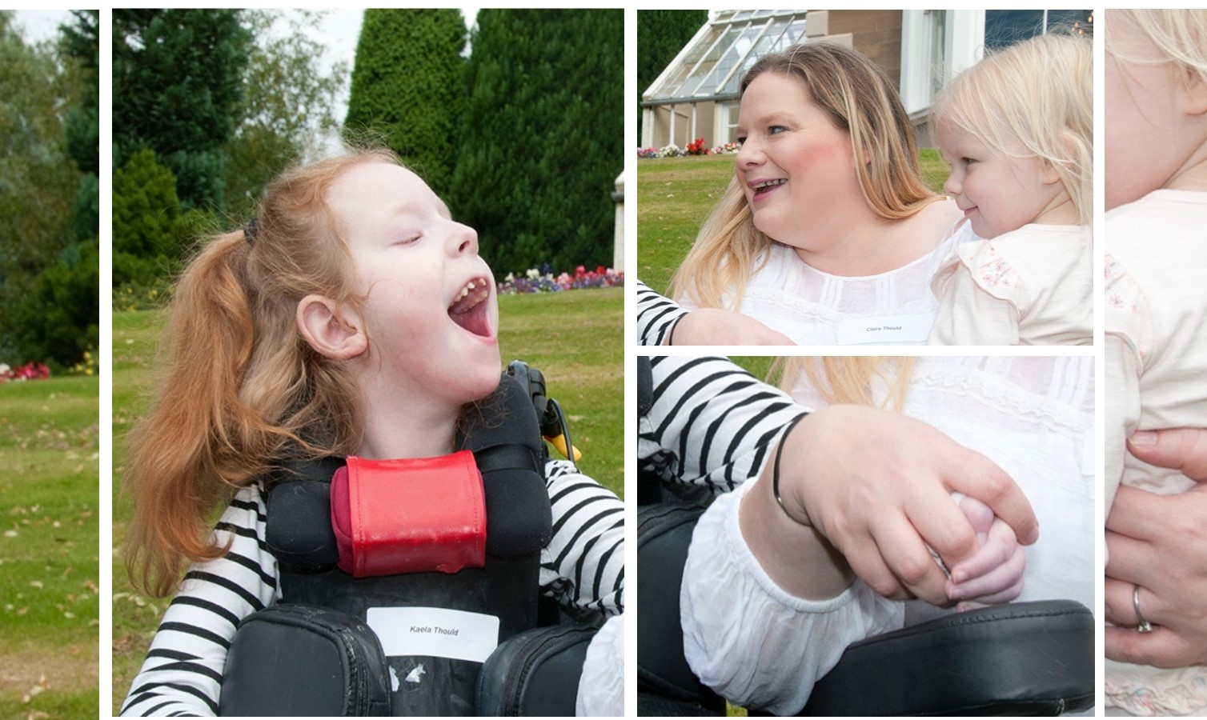
My Contacts
Notes:
Important and relevant people and their contact details should be included within the emergency contacts section

Slide 41
My Contacts
Contacts can be split into many sections depending on what the person would like to include. These could be personal contacts ie friends and family, sports and leisure contacts, contacts with practitioners, links to cinemas or concert venues that the person visits, or people who work or service individual’s equipment or train their staff.
This section can include their birthday lists, or any special holidays or rememberance days that the person holds important. Who gets a postcard when the person is on holiday? Who gets a card or gift on their birthday from the person and how much is usually spent? Who does the person go out for coffee with?

Slide 42
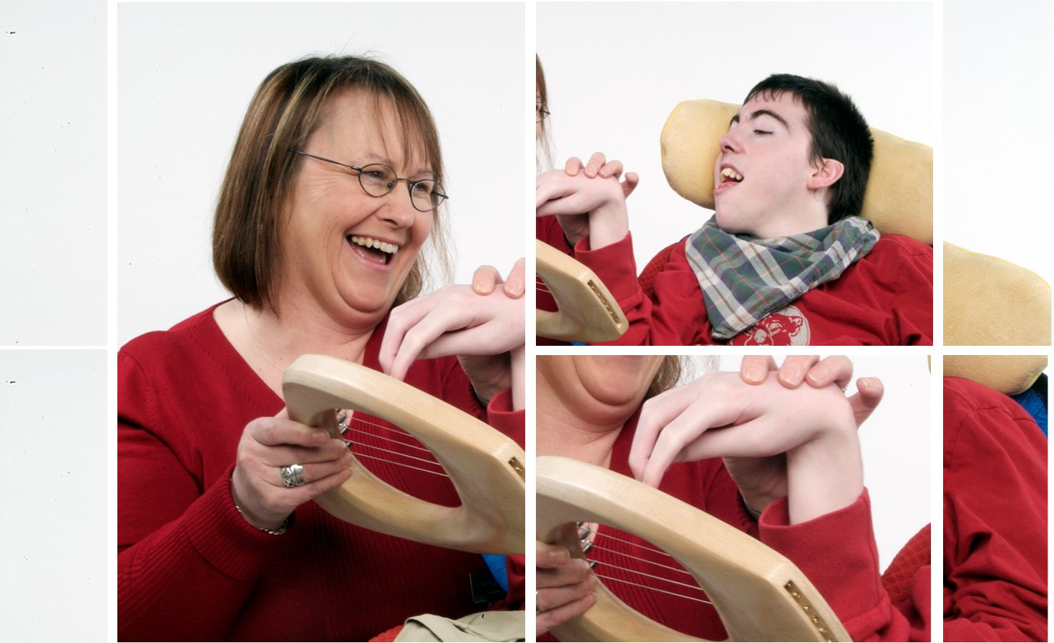
Plans and Documents
Notes:
This is the outside cover and is usually a recent photo of the person. The person’s photo is accompanied by their name and a short introductory sentence inviting the reader to find out about the person.

Slide 43
Guardianship
A guardianship document can be embedded here, or details written down.
Notes:
This is the outside cover and is usually a recent photo of the person. The person’s photo is accompanied by their name and a short introductory sentence inviting the reader to find out about the person.

Slide 44
Hospital Passport – Please ensure date is added
Correct as of / / 202-
If someone already has an up to date hospital passport, information can be used from that, or it can be embedded as a document. If not, some suggested information is:
My Name is:
I prefer to be called:
My preferred pronouns are: he/she/they/other (please state)
My date of Birth is:
My CHI Number is:
This is how I communicate:
This is the language I speak or understand:
This is what I look like when I’m well (photograph or video)
This is what I look like when I’m unwell (photograph or video)
My emergency Contact is:
I have/have not got an Anticipatory Care Plan in place?
Essential information about me is:
(This might include information about usual temperature, catheter size, ongoing conditions, sensory support, behavioural support)
People that support me:
(This might include information about Consultants, Allied Heath professionals)
Please add slides as required
Notes:
This is the outside cover and is usually a recent photo of the person. The person’s photo is accompanied by their name and a short introductory sentence inviting the reader to find out about the person.

Slide 45
Help Me in Hospital – please use my name
When I am ill you will find this useful to know while my notes are found
These pages have been compiled by Paediatrician, Dr Una MacFadyen and the Children with Exceptional Needs Managed Clinical Network to support acute hospital admission.
How I react to being ill
Pain makes me ------
When I am breathless I ------
If I feel sick I----------
My usual pulse rate is----
My usual BP is--------
Past times like this were due to -------
I react badly to -------
If I need pain or fever relief I am best with -------
If I need antibiotics I usually respond best to ----------
My special hates are -----------
The person who knows me best is ----
My favourite distraction is--------
Notes:
This is the outside cover and is usually a recent photo of the person. The person’s photo is accompanied by their name and a short introductory sentence inviting the reader to find out about the person.

Slide 46
Help Me in Hospital – please use my name
When I am ill you will find this useful to know while my notes are found
These pages have been compiled by Paediatrician, Dr Una MacFadyen and the Children with Exceptional Needs Managed Clinical Network to support acute hospital admission.
How you can make a difference
Keep background noise down
Avoid bright lights in the room
Speak clearly and slowly, not loudly
Tell me what you are going to do to me
Show me where you are going to touch me before you do
Tell me when new things are going to happen
Let me sit up or tell me why you are preventing this
Try to keep the same person with me
Use my communication aids
Tell me when I can relax and that you will tell me what comes next at the time
Notes:
This is the outside cover and is usually a recent photo of the person. The person’s photo is accompanied by their name and a short introductory sentence inviting the reader to find out about the person.

Slide 47
Help Me in Hospital – please use my name
When I am ill you will find this useful to know while my notes are found
These pages have been compiled by Paediatrician, Dr Una MacFadyen and the Children with Exceptional Needs Managed Clinical Network to support acute hospital admission.
Neurology
Respiratory
Nutrition
Renal/Continence
Dental
Mental health
Communication
Environment
Pain control
Notes:
This is the outside cover and is usually a recent photo of the person. The person’s photo is accompanied by their name and a short introductory sentence inviting the reader to find out about the person.

Slide 48
Help Me in Hospital – please use my name
When I am ill you will find this useful to know while my notes are found
These pages have been compiled by Paediatrician, Dr Una MacFadyen and the Children with Exceptional Needs Managed Clinical Network to support acute hospital admission.
Dr,
ANP
Physio
Dietitian,
SLT
Dr Anp, stoma care
GDP, Hygienist
Psych, LD team
Notes:
This is the outside cover and is usually a recent photo of the person. The person’s photo is accompanied by their name and a short introductory sentence inviting the reader to find out about the person.

Slide 49
Help Me in Hospital – please use my name
When I am ill you will find this useful to know while my notes are found
These pages have been compiled by Paediatrician, Dr Una MacFadyen and the Children with Exceptional Needs Managed Clinical Network to support acute hospital admission.
Light
Noise
Smell
Texture
Signs
Control
Notes:
This is the outside cover and is usually a recent photo of the person. The person’s photo is accompanied by their name and a short introductory sentence inviting the reader to find out about the person.

Slide 50
Anticipatory Care Plan
If someone has an anticipatory care plan it may be added here
Notes:
This is the outside cover and is usually a recent photo of the person. The person’s photo is accompanied by their name and a short introductory sentence inviting the reader to find out about the person.

Slide 51
Sports Accessibility Plan
It’s really useful to work with sports practitioners to look at how someone can be supported to take part in sport and leisure activities. Please add slides as needed.
Notes:
This is the outside cover and is usually a recent photo of the person. The person’s photo is accompanied by their name and a short introductory sentence inviting the reader to find out about the person.

